Slide 1
Cyclistic Bike-Share
Case Study
How do annual members and casual riders use Cyclistic bikes differently?
Joel Thielman - last updated 9/13/23

Slide 2
How do annual members and casual riders use Cyclistic bikes differently?
How many rides are annual members taking compared to casual riders?
How do ride durations vary between annual members and casual riders?
What days of the week are the busiest? Least busy?

Slide 3
Overview of Cyclistic users
Q2 2019 - Q1 2020
Percentage of riders with annual memberships:
Busiest day of week (annual members):
Busiest day of week (casual riders):
Average duration of ride (annual members):
Average duration of ride (casual riders):
77%
Tuesday
Saturday
59m 13s
14m 10s

Slide 4
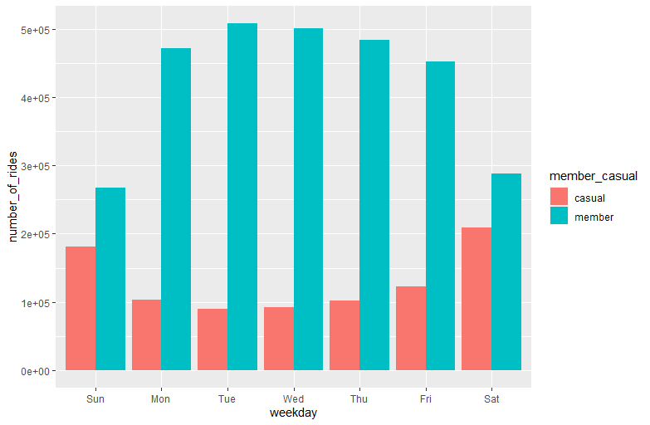
Number of rides
600k
400k
300k
number of riders
200k
100k
0
There are significantly more member rides than casual rides every day, especially weekdays.

Slide 5
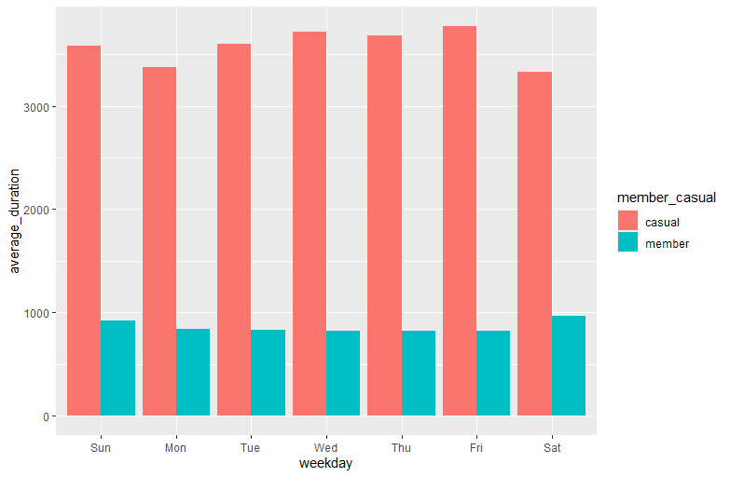
Average duration of rides
Casual rides are significantly longer than member rides every day consistently.

Slide 6
Key findings
There are significantly more member rides than casual rides every day, especially weekdays.
Casual rides are significantly longer than member rides every day consistently.
Members are probably riding to and from work on weekdays, which accounts for their rides being shorter and more regular.
Casual riders are probably riding during their free time, which accounts for their rides being consistently longer and more concentrated on weekends.

